Slide 1


Prediction on Diabetes Patient's Hospital Readmission by using naïve bayes classifier
M.Mounika

Slide 2
Problem Statement:
To identify the factors that lead to the high readmission rate of diabetic patients within 30 days post discharge and correspondingly to predict the high-risk diabetic-patients who are most likely to get readmitted within 30 days so that the quality of care can be improved along with improved patient’s experience, health of the population and reduce costs by lowering readmission rates. Also, to identify the medicines that are the most effective in treating diabetes

Slide 3
Data Set Description
Encounter ID: Unique identifier of an encounter
Patient number: Unique identifier of a patient
Race Values: Caucasian, Asian, African American, Hispanic, and other
Gender Values: male, female, and unknown/invalid Age Grouped in 10-year intervals: 0, 10), 10, 20), …, 90, 100)
Weight: Weight in pounds
Admission type: Integer identifier corresponding to 9 distinct values, for example, emergency, urgent, elective, newborn, and not available
Discharge disposition: Integer identifier corresponding to 29 distinct values, for example, discharged to home, expired, and not available
Admission source: Integer identifier corresponding to 21 distinct values, for example, physician referral, emergency room, and transfer from a hospital
Time in hospital: Integer number of days between admission and discharge
Payer code : Integer identifier corresponding to 23 distinct values, for example, Blue Cross/Blue Shield, Medicare, and self-pay Medical

Slide 4
Medical specialty: Integer identifier of a specialty of the admitting physician, corresponding to 84 distinct values, for example, cardiology, internal medicine, family/general practice, and surgeon
Number of lab procedures: Number of lab tests performed during the encounter
Number of procedures: Numeric Number of procedures (other than lab tests) performed during the encounter
Number of medications: Number of distinct generic names administered during the encounter
Number of outpatient visits: Number of outpatient visits of the patient in the year preceding the encounter
Number of emergency visits: Number of emergency visits of the patient in the year preceding the encounter
Number of inpatient visits: Number of inpatient visits of the patient in the year preceding the encounter
Diagnosis 1: The primary diagnosis (coded as first three digits of ICD9); 848 distinct values
Diagnosis 2: Secondary diagnosis (coded as first three digits of ICD9); 923 distinct values
Diagnosis 3: Additional secondary diagnosis (coded as first three digits of ICD9); 954 distinct values
Number of diagnoses: Number of diagnoses entered into the system 0%

Slide 5
Glucose serum test: result indicates the result’s range or if the test was not taken. Values: “>200,” “>300,” “normal,” and “none” if not measured
A1c test result: Indicates the range of the result or if the test was not taken. Values: “>8” if the result was greater than 8%, “>7” if the result was greater than 7% but less than 8%, “normal” if the result was less than 7%, and “none” if not measured.
Change of medications: Indicates if there was a change in diabetic medications (either dosage or generic name). Values: “change” and “no change”
Diabetes medications: Indicates if there was any diabetic medication prescribed. Values: “yes” and “no” 24 features for medications For the generic names: metformin, repaglinide, nateglinide, chlorpropamide, glimepiride, acetohexamide, glipizide, glyburide, tolbutamide, pioglitazone, rosiglitazone, acarbose, miglitol, troglitazone, tolazamide, examide, sitagliptin, insulin, glyburide-metformin, glipizide-metformin, glimepiride- pioglitazone, metformin-rosiglitazone, and metformin- pioglitazone, the feature indicates whether the drug was prescribed or there was a change in the dosage. Values: “up” if the dosage was increased during the encounter, “down” if the dosage was decreased, “steady” if the dosage did not change, and “no” if the drug was not prescribed
Readmitted (Target Column): Days to inpatient readmission. Values: “<30” if the patient was readmitted in less than 30 days, “>30” if the patient was readmitted in more than 30 days, and “No” for no record of readmission

Slide 6
Variable identification
1. Independent variables (49): encounter_id, patient_nbr, race, gender, age, weight, admission_type_id, discharge_disposition_id, admission_source_id, time_in_hospital, payer_code, medical_specialty, num_lab_procedures, num_procedures, num_medications, number_outpatient, number_emergency, number_inpatient, diag_1, diag_2, diag_3, number_diagnoses, max_glu_serum, A1Cresult, metformin, repaglinide, nateglinide, chlorpropamide, glimepiride, acetohexamide, glipizide, glyburide, tolbutamide, pioglitazone, rosiglitazone, acarbose, miglitol, troglitazone, tolazamide, examide, citoglipton, insulin, glyburide-metformin, glipizide-metformin, glimepiride-pioglitazone, metformin-rosiglitazone, metformin-pioglitazone, change, diabetesMed.

Slide 7
2. Dependent variable (1): readmitted (Categorical)
Extra Info: Our dataset consists of hospital admissions of length between one and 14 days that did not result in a patient’s death. Each encounter corresponds to a patient diagnosed with diabetes, although the primary diagnosis may be different. During each of the analyzed encounters, lab tests were ordered and medication was administered

Slide 8
Project Definition
Predict if a patient with diabetes will be readmitted to the hospital within 30 days

Slide 9
Here are the steps you can follow to work with the hospital readmission dataset how to build a model predicting readmission in python by using following stepsn Python using the following steps using the following steps :
Load the dataset:
Preprocess the data:
2.1: Handling missing information
2.2: Handling irrelevant information
2.3: Simplifying categories
2.4: Reducing number of categories
Data Exploration
Data visualization
Feature Engineering
Spliting Train and Test
Model Building

Slide 10
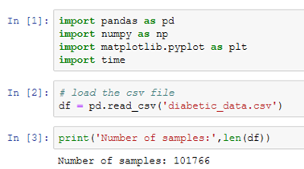
Load the dataset
In this dataset, we will utilize Python to build the predictive model. Let’s begin by loading the data and exploring some of the columns.

Slide 11
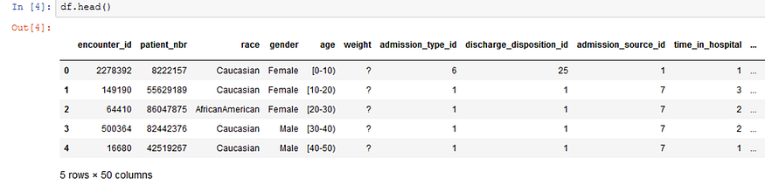
From briefly, looking through the data columns, we can see there are some identification columns, some numerical columns, and some categorical (free-text) columns. These columns will be described in more detail below.

Slide 12
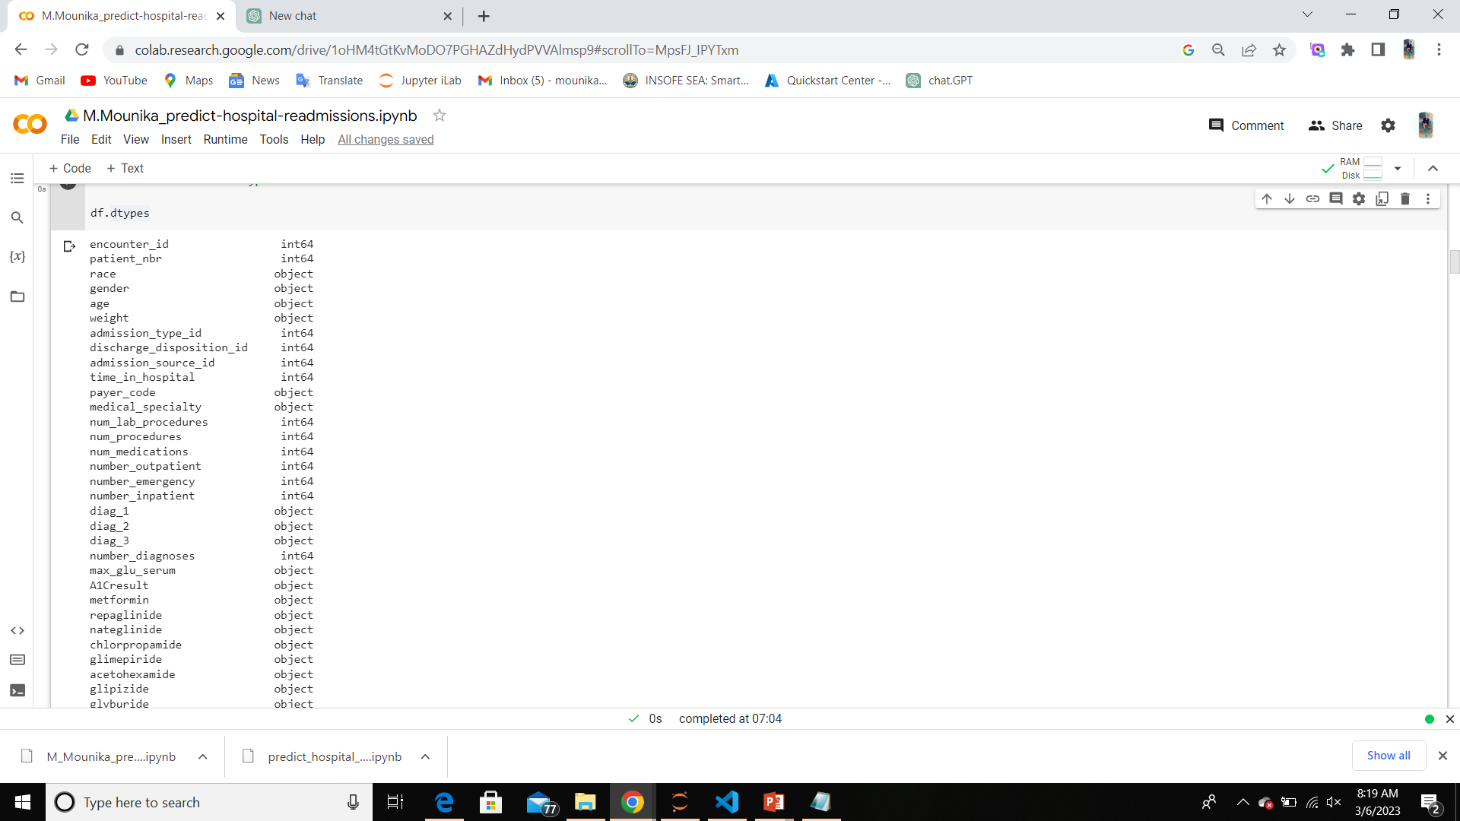
The dtypes attribute of a pandas DataFrame returns the data type of each column in the DataFrame. You can use it to check the data types of the columns in df. To get the data types of the columns in df, you can use the following code:

Slide 13
2: Preprocess Data
2.1: Handling missing information
2.2: Handling irrelevant information
2.3: Simplifying categories
2.4: Reducing number of categories

Slide 14
2.1: Handling Missing Information
Regarding the weight, payer_code and medical_specialty columns, we've decided to drop these columns because there is an overwhelming amount of missing information (close to 50% or more).
Regarding the gender column, we removed 3 rows with Unknown/Invalid data.

Slide 15
2.2 Handling Irrelevant Variables
Diag_2 and diag_3 are dropped because we're only considering primary diagnosis.
There are patients that have multiple encounters. In order to reduce the bias, we kept the first patient encounter and removed all the other encounters. Encounter_id and patient_nbr columns were then dropped.
There are 22 columns describing the change in individual medications. We dropped all the columns since there is already one column with regards to medication change on a whole (change).

Slide 16
2.3: Simplifying Categories
Next, we'll encode the age column with the numbers 1 to 10 so that they can still retain their order of ranking.

Slide 17
2.4: Reducing the Number of Categories
There are 4 columns with too many categories, namely: diag_1, admission_source_id, discharge_disposition_id and admission_source_id.
We need to reduce the number of categories by grouping them together.
For diag_1, we can refer to the icd9 codes to generalize an appropriate description.
For race, we combined 2 categories together: ? and other.

Slide 18
3. Data Exploration
Since we're only interested in factors leading to early readmission, we will convert readmitted into a binary variable with two classes:
1 for readmission in less than 30 days (<30)
0 for otherwise which includes no readmission (NO) and readmission in more than 30 days (>30)

Slide 19
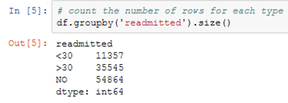
The most important column here is readmitted, which tells us if a patient was hospitalized within 30 days, greater than 30 days or not readmitted.

Slide 20
4. Data Visualization
Next, we will plot the distribution of each feature/column in relation with the frequency of early admissions.
We can identify features that are good predictors of early readmissions if the data is sufficiently varied.

Slide 21
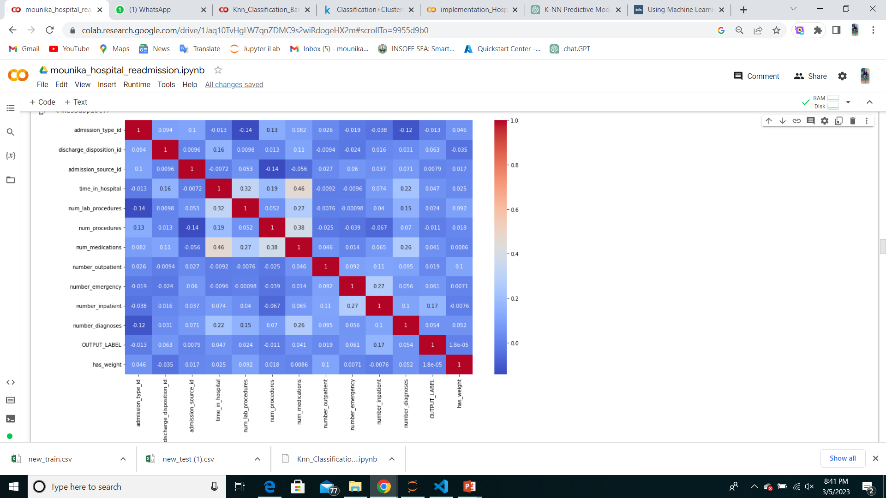
data VISUALIZATION
corr = df.corr()
plt.figure(figsize=(15, 9))
sns.heatmap(corr, annot=True, cmap='coolwarm')

Slide 22
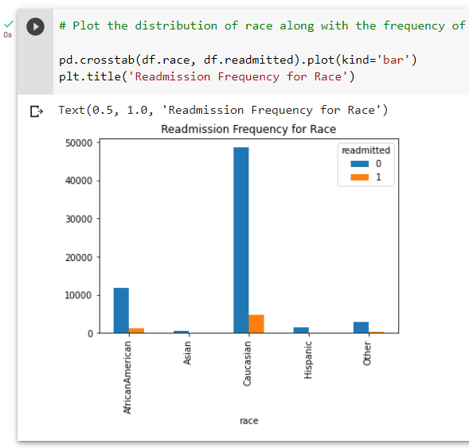
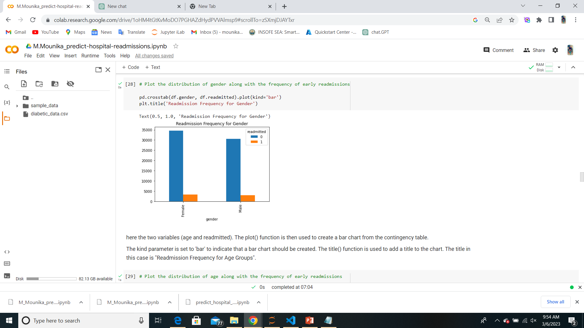
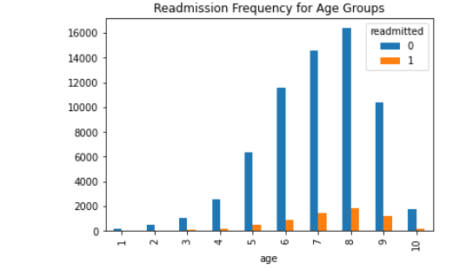
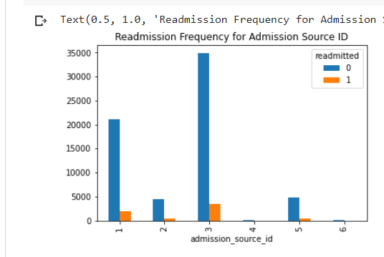
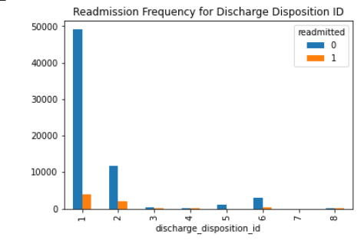
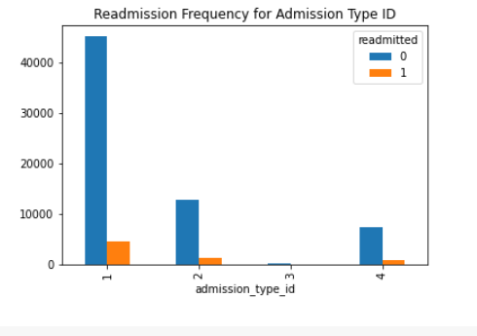

Slide 23
5. Feature Engineering
5: Create Dummy Variables
When dealing with categorical variables, we need to assign numerical values to different categories within each column.
Dummy variables helps us classify the data into mutually exclusive categories

Slide 24
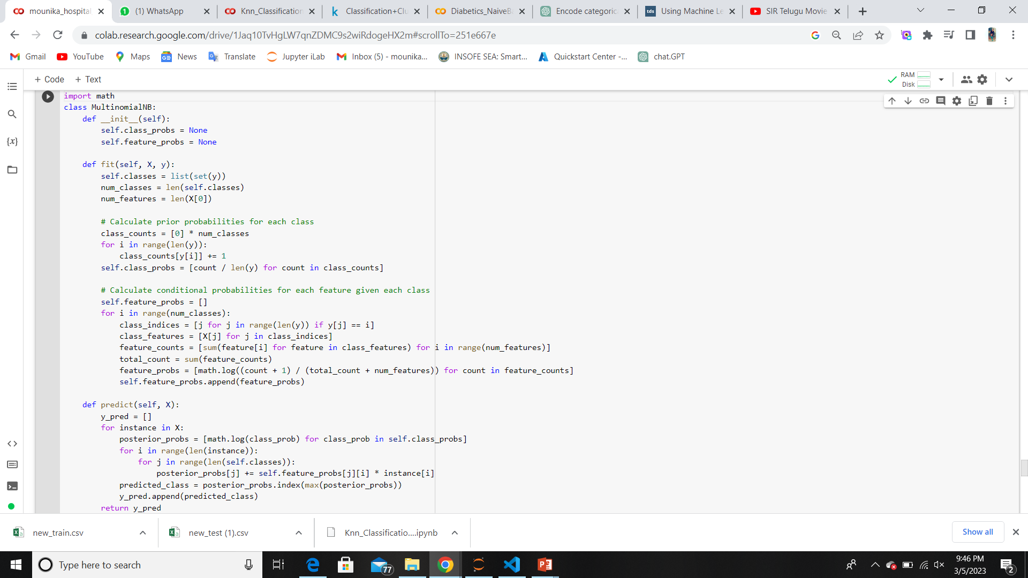
Model Building:

Slide 25
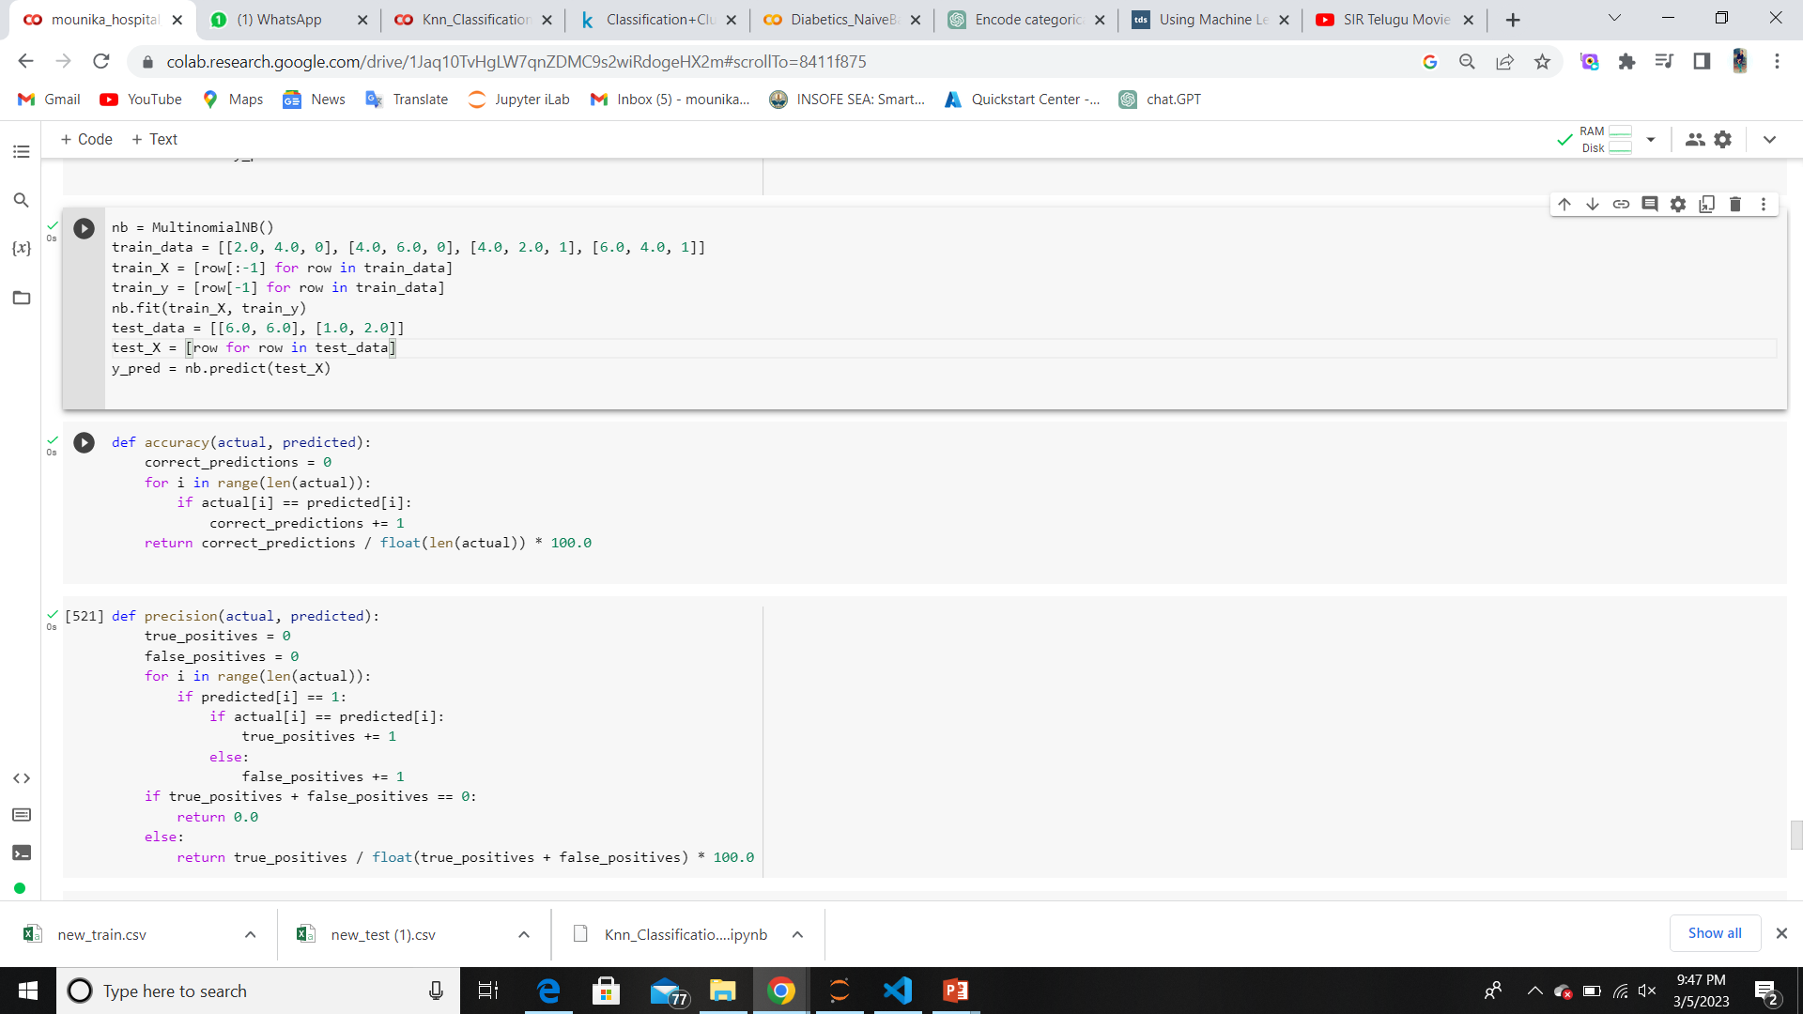

Slide 26
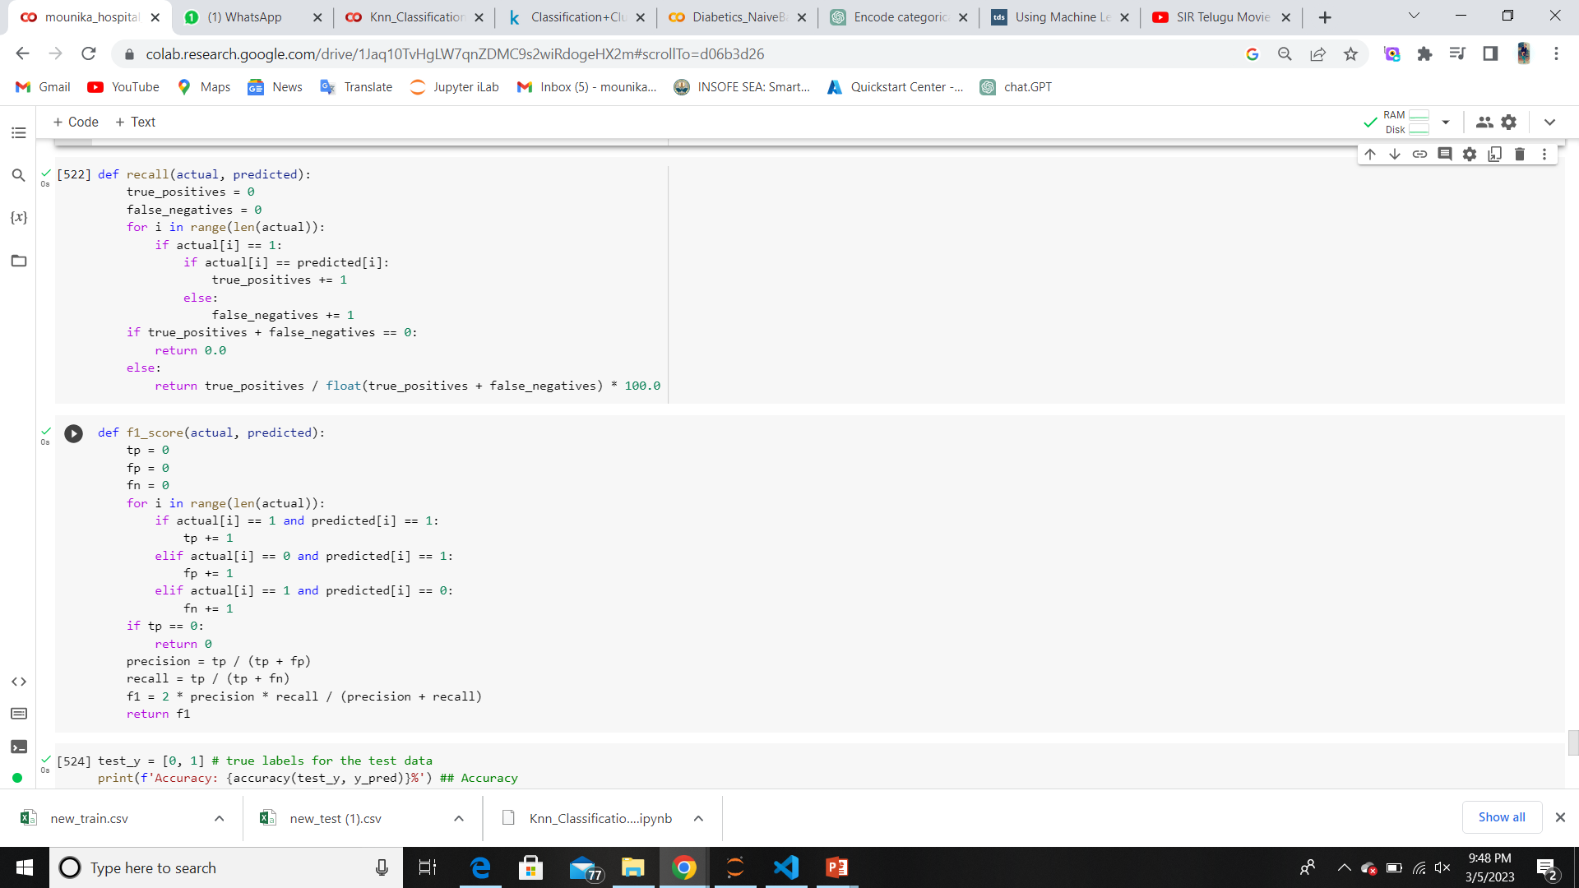

Slide 27
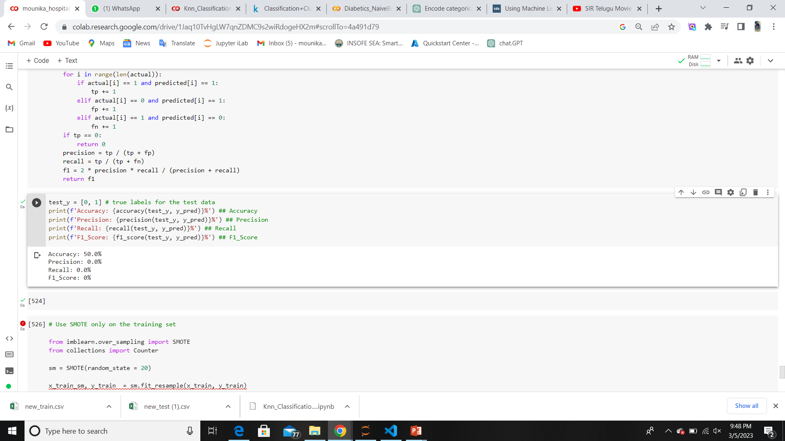
Result:

Slide 28


